Slide 1
Evolved Gas Analysis of Carbonaceous Chondrites in Application to NASA’s OSIRIS-REx
Katherina Marchese, University of Arizona
Dante Lauretta, OSIRIS-REx Principle Investigator

Slide 2
Chondrite Overview
Chondrites are organized and divided into subgroups:
Carbonaceous, Ordinary, Enstatite, Kakangari, and Rumuruti
Beyond the main subdivision, chondrites are divided and organized into chemical groups based on petrologic type.
Carbonaceous chondrites are among some of the most primitive materials from early solar system formation approximately 4.5 billion years ago

Slide 3
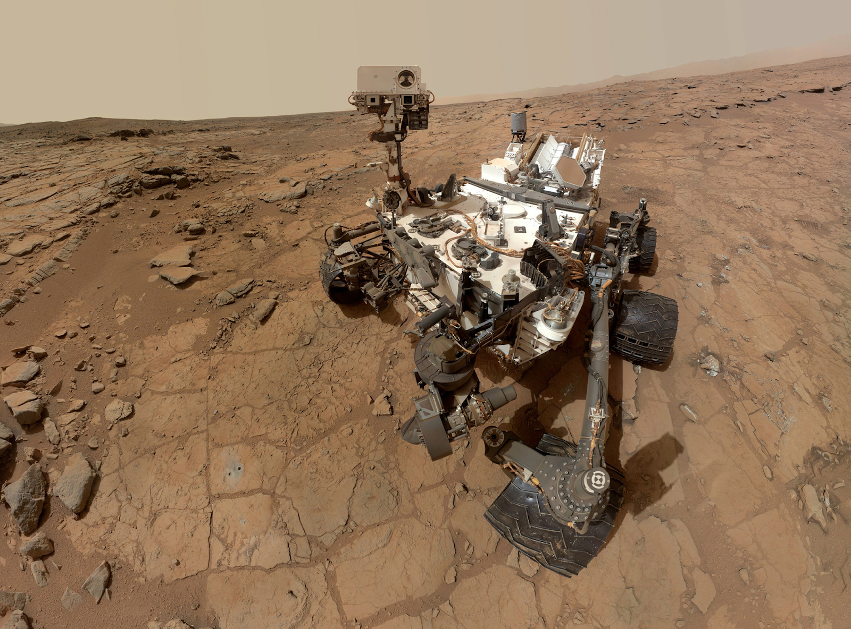
SAM Evolved Gas Analysis
The purpose of evolved gas analysis is collect mass spectrometry data on volatile elements and compounds within samples.
The focus of this project involves interpreting this data to predict the loss of volatile elements in meteorites when exposed to high temperatures, such as entering Earth’s atmosphere.
Source: NASA

Slide 4
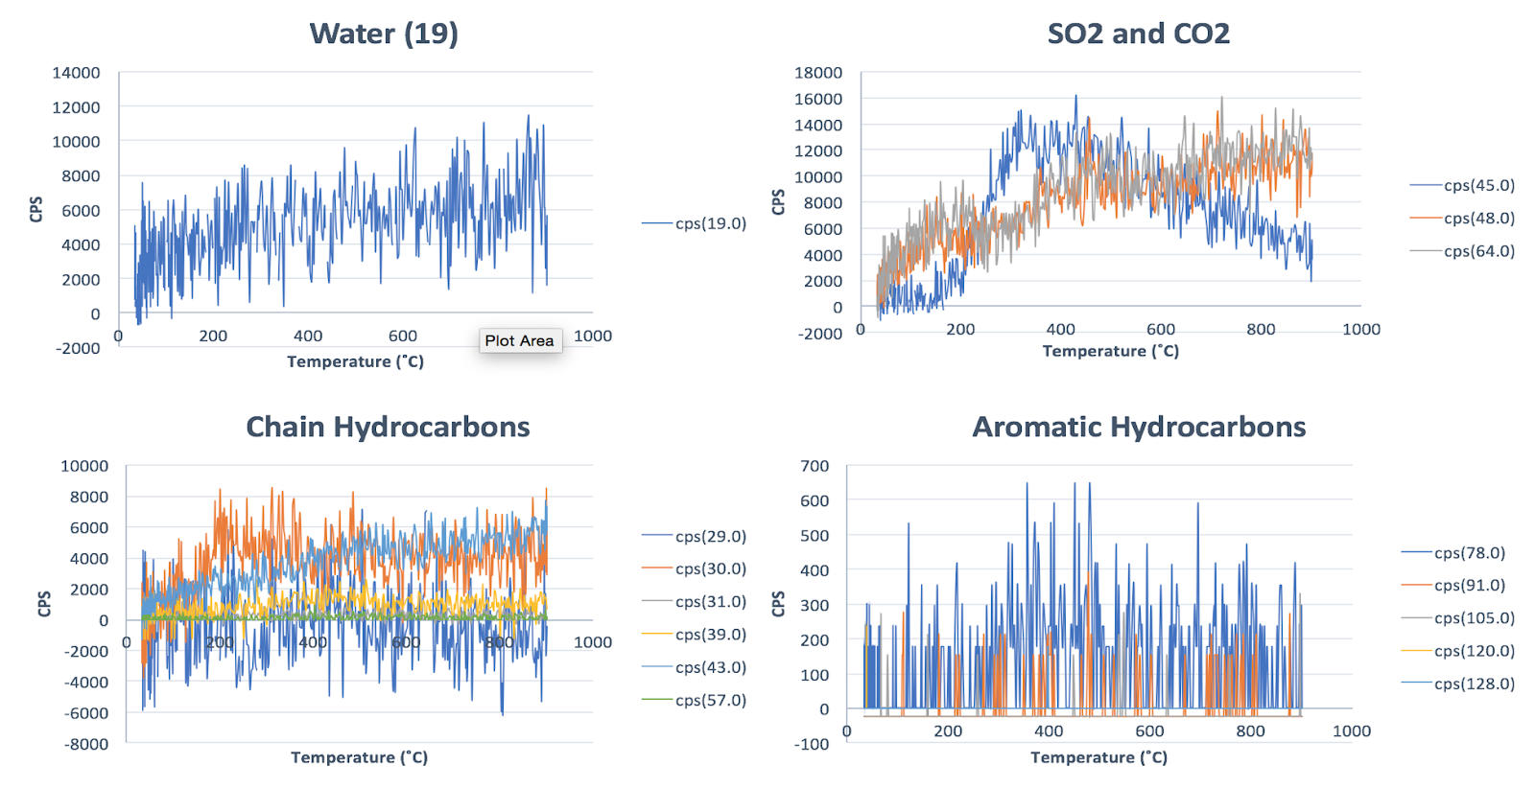
CO Chondrite: Ornans
Ornans is a type specimen for the CO3 group within the branch of carbonaceous chondrites. The chondrite’s fall was observed in France in 1968.
A typical CO chondrite (Carbonaceous Ornans) contain a matrix that is more abundant than ordinary chondrites.
Most CO chondrites have experienced some degree of thermal metamorphism, however is unlikely affected by aqueous alteration.
Figure 1: EGA Data from Ornans Meteorite

Slide 5
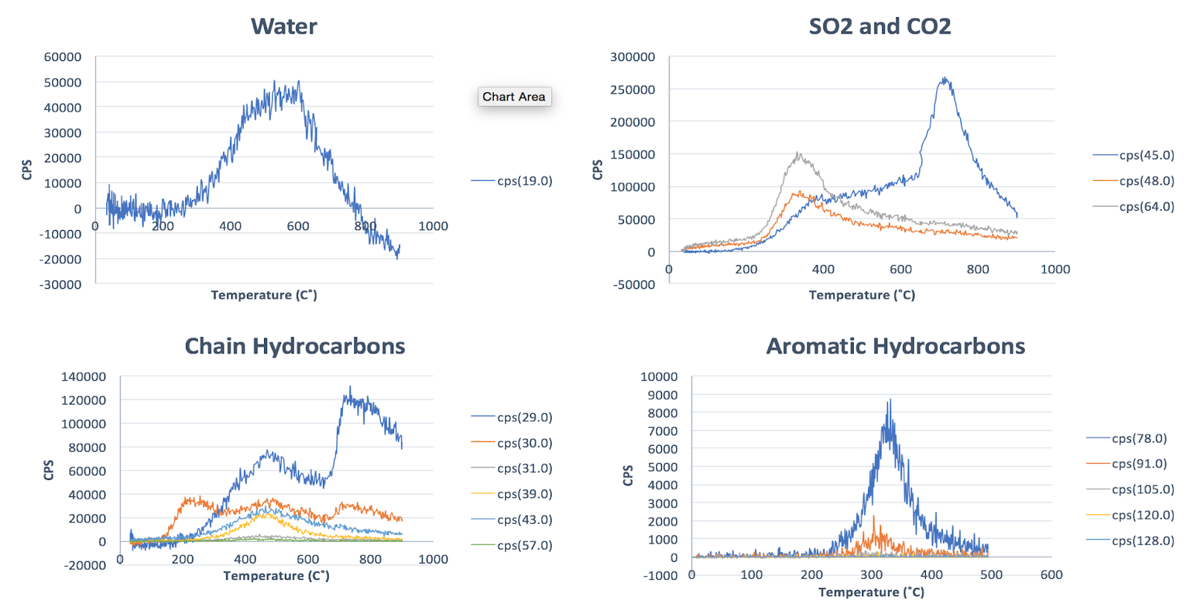
CM Chondrites: Murray and Cold Bokkeveld
CM (carbonaceous Mighei-like) Chondrites
Type 1 CM chondrites are completed hydrated by aqueous alteration.
Both Cold Bokkeveld and Murray are classified as CM2 carbonaceous chondrites.
Murray was discovered in 1950 after an observed fall. Cold Bokkeveld was discovered in South Africa in 1838.
Figure 3: EGA Data from Cold Bokkeveld Meteorite

Slide 6
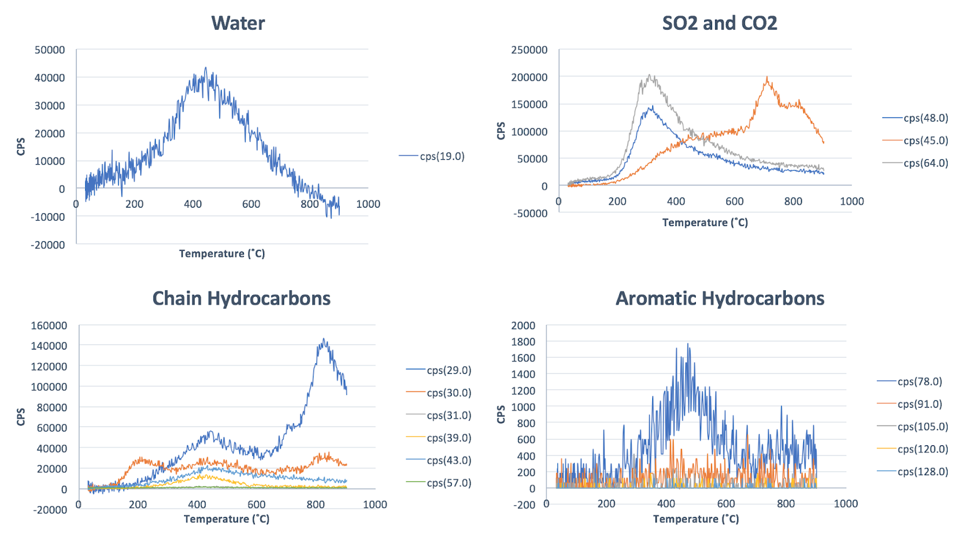
Figure 3: EGA Data from Murray Meteorite

Slide 7
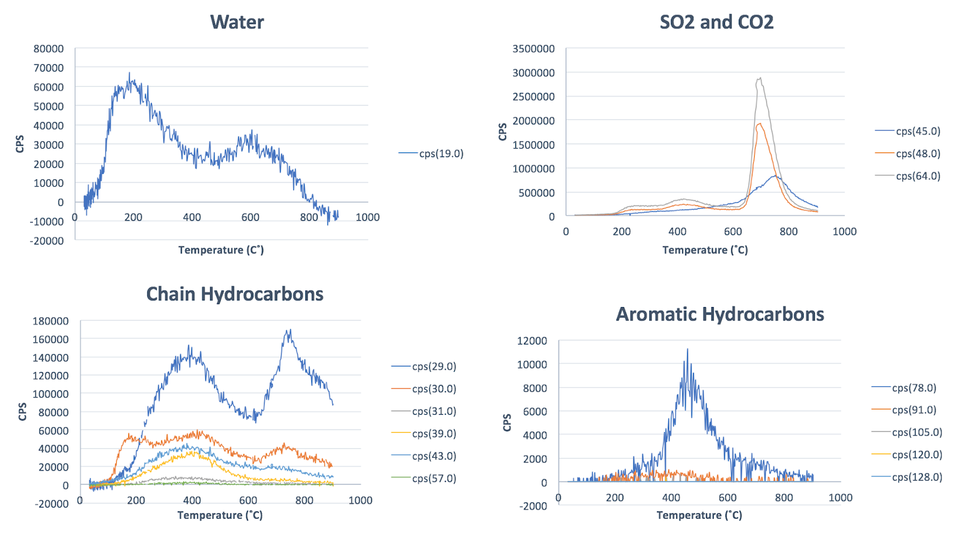
CI Chondrite: Orgueil
CI1 (carbonaceous Ivuna-like) carbonaceous chondrite
Known to have compositions that are similar to the sun’s photosphere.
Its’ fall was observed in France in 1864, and is one of the five known meteorites belonging to the CI classification.
Presolar grains have been observed in Orgueil.
Figure 4: EGA Data from Orgueil Meteorite

Slide 8
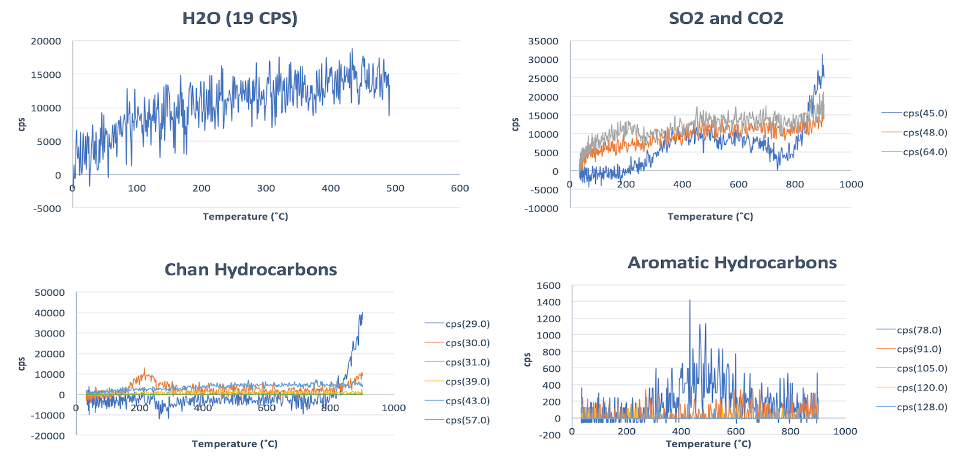
CV Chondrite: Allende
CV (carbonaceous Vigarano-like) chondrites
CV chondrites also consist of the oxidized and reduced subtypes: CV-oxA, CV-oxB, and CV-red. The oxidized subgroup CV-oxA (oxidized, Allende-like)
One of the most famous meteorites is the Allende chondrite, which fell in Mexico in 1969.
Figure 5: EGA Data from Allende Meteorite

Slide 9
Calculation of Abundances
Ornans | H2O @ Mass 19 | H2O @ Mass 20 | Benzene (78)
mols | 1.60E-05 | 1.28E-05 | 4.03E-11
umol | 16.05 | 12.83 | 4.03E-05
Wt % of Sample | 1.85 | 1.48 | 4.66E-06
Abundances for water and benzene were taken using an ionization cross section ratio of CO2.
Source:
Archer, Paul Douglas, et al. “Abundances and Implications of Volatile-Bearing Species from Evolved Gas Analysis of the Rocknest Aeolian Deposit, Gale Crater, Mars.” Journal of Geophysical Research: Planets, vol. 119, no. 1, 2014, pp. 237–254.
Orgueil | H2O @ Mass 19 | H2O @ Mass 20 | Benzene (78)
mols | 4.42E-05 | 3.85E-07 | 4.03E-11
umol | 44.24 | 0.38 | 4.03E-05
Wt % of Sample | 6.13 | 0.05 | 4.66E-06
Allende | H2O @ Mass 19 | H2O @ Mass 20 | Benzene (78)
mols | 2.39E-05 | 2.72E-05 | 6.08E-11
umol | 23.90 | 27.21 | 6.08E-05
Wt % of Sample | 1.37 | 1.56 | 3.48E-06

Slide 10
Abundances Continued
Murray | H2O @ Mass 19 | H2O @ Mass 20 | Benzene (78)
mols | 1.82E-05 | 8.88E-05 | 8.47E-08
umol | 18.25 | 88.83 | 8.47E-02
Wt % of Sample | 2.63 | 12.79 | 1.22E-02
Cold Bokkeveld | H2O @ Mass 19 | H2O @ Mass 20 | Benzene (78)
mols | 6.70E-05 | 4.83E-05 | 5.29E-10
umol | 67.04 | 48.26 | 5.29E-04
Wt % of Sample | 10.68 | 7.69 | 8.43E-05

Slide 11
Significant Findings
It is important to recognize the volatility of important carbon based molecules and water, because on return, it can help predict and account for losses from enviable outcomes on return of samples from Bennu
There is a significant amount of water-bearing minerals present in the bulk chemistry in CM and CI chondrites.
Limitations to SAM breadboard

Slide 12

Acknowledgments
Special thanks to:
NASA Space Grant Consortium
Dante Lauretta, PI of OSIRIS-REx,
Heather Franz, NASA Goddard Space Flight Center

